Slide 1
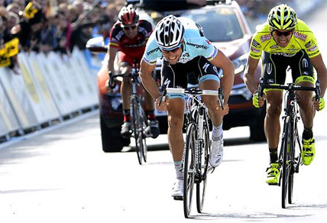
Cycling Injury Prevention
What you can do NOW to prevent injuries, and increase cycling performance
Brad Conner, DO
Summit Sports Medicine

Slide 2
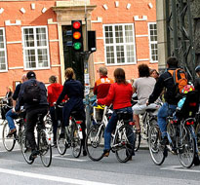
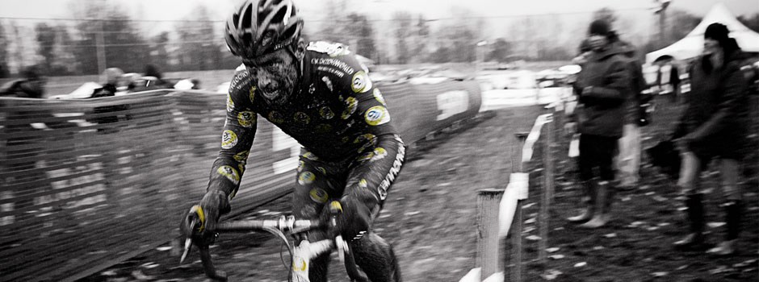
A Nation of Cyclists
Over 100 million Americans ride bicycles
Of those, 5 million cyclists ride 20 days/month
In total, cycling injuries result in 500,000 Physician visits/year!
Estimated cost of 8 BILLION dollars
YOU can change this with simple preventative measures!

Slide 3
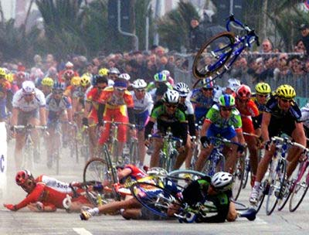
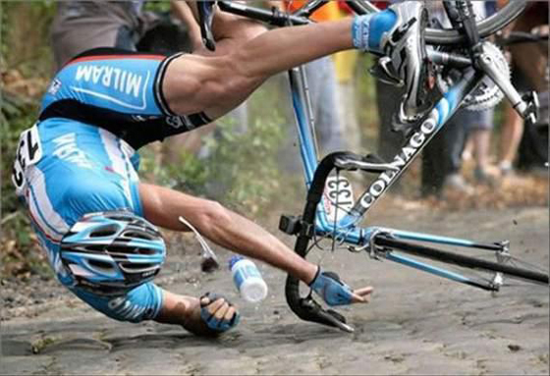
Etiology of Injury
Traumatic (acute)
Happens suddenly, i.e. concussion, torn muscle/tendon/ligament, strains/sprains
fractured bones, lacerations, abrasions, etc.
Less common than overuse injuries
Will most likely require immediate medical attention

Slide 4
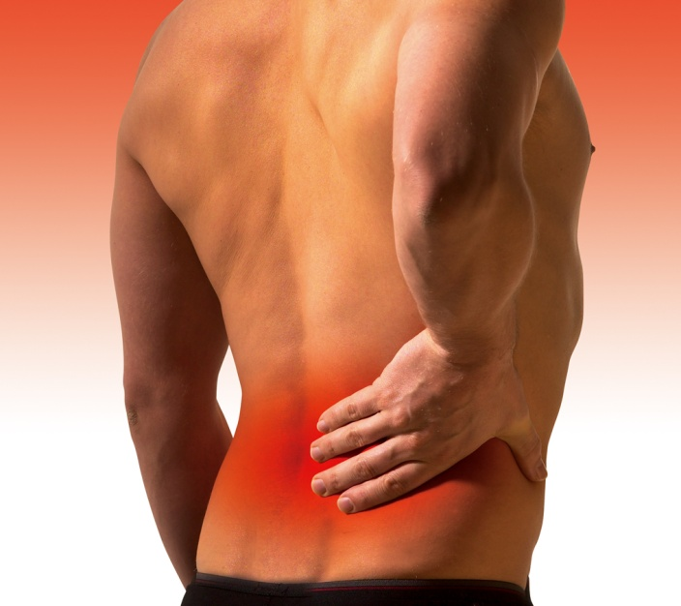
Etiology of Injury
Overuse/Repetitive (chronic)
Develops over a longer period of time, i.e. low back pain, neck pain, Piriformis Syndrome,
IT Band Syndrome, Ulnar Palsy (Cyclist’s hand), Carpal Tunnel Syndrome, Tendonitis/Tendonosis,
Nerve Entrapment, knee pain, etc.
More common than traumatic injuries
Can be treated with conservative care, rehab, and
proper bike fitting (biomechanics)
Usually brought on with increased training time/mileage
& intensity

Slide 5
Overuse/Repetitive Injury Cycle

Slide 6
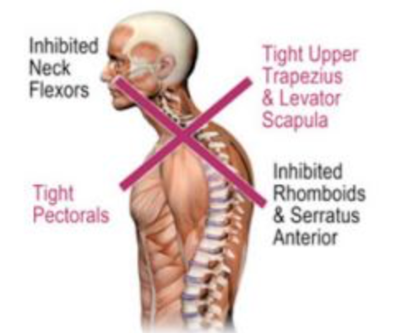
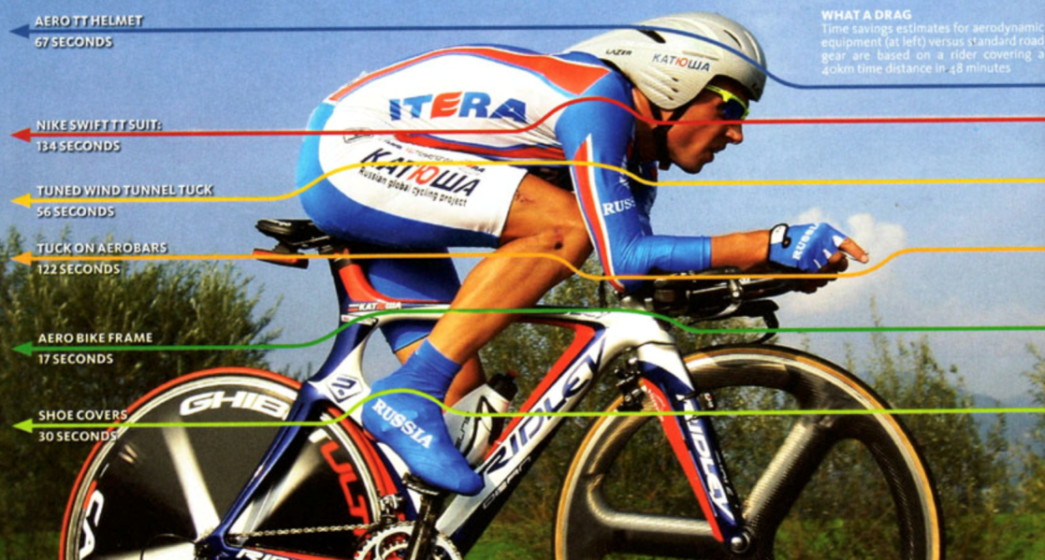
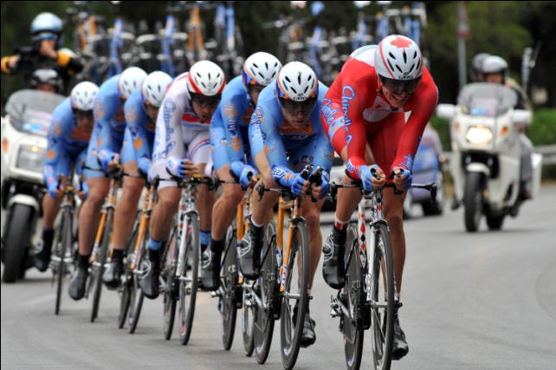
Neck Pain
Causes
Neck is in extension for long periods of time
(aero position), constricting the soft tissue
Muscular Imbalances (Upper Cross Syndrome)
Poor spine mobility
Seat too far back/handlebars too low
Possible degeneration in spine (DDD), prominent in older cyclists

Slide 7
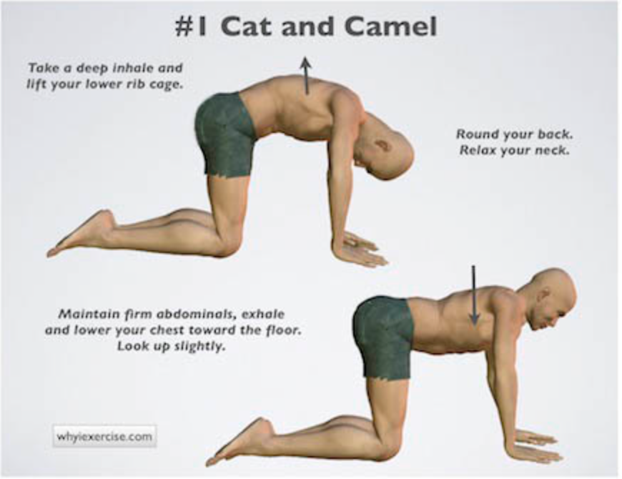
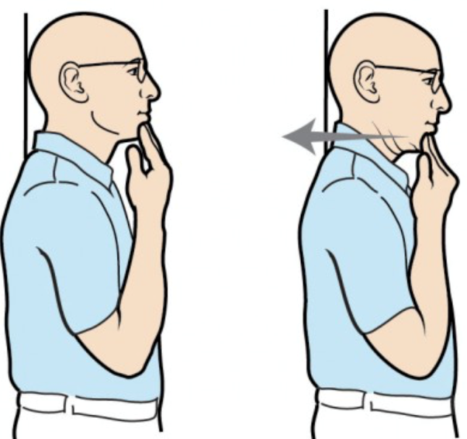
Treatment for Neck Pain
Improve joint mobility (cervical & thoracic)
Strengthen neck/upper back
Cat/Camel Stretch
Chin tucks
Isometric Strengthening

Slide 8
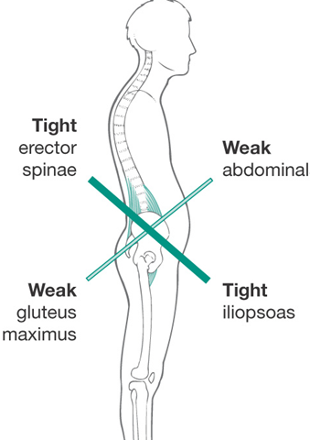
Low Back Pain
Causes
Tight/constricted muscles
Muscular Imbalances
(Lower Cross Syndrome)
Lack of spinal mobility
Poor Core Strength
Seat too high/Seat too far back/Handle bar too low

Slide 9
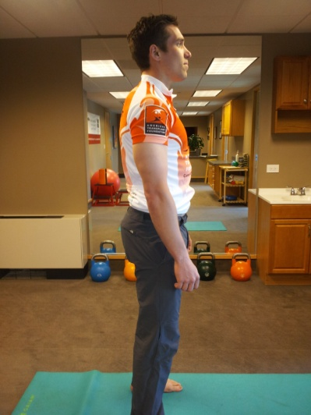
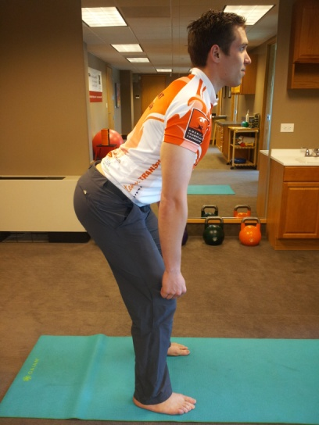
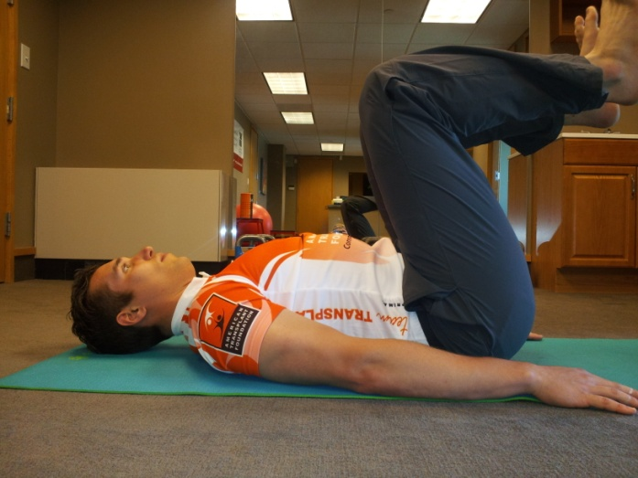
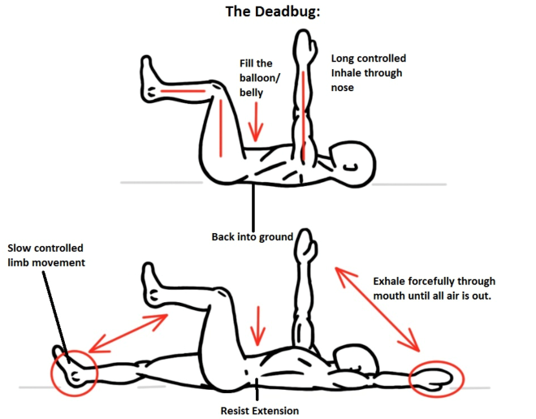
Treatment for Low Back Pain
Flexibility (hamstrings, hip flexors (iliopsoas), low back)
Hip hinge
Dead Bug
Notes:
Hip hinge = posterior chain: glutes, ham, low back
Dead bug = strengthen core/abs, good for low back issues. Keep back flat/belly button in towards spine. Alternate hands and leg, then add medicine ball. 2-3 sets for 8-10 reps

Slide 10
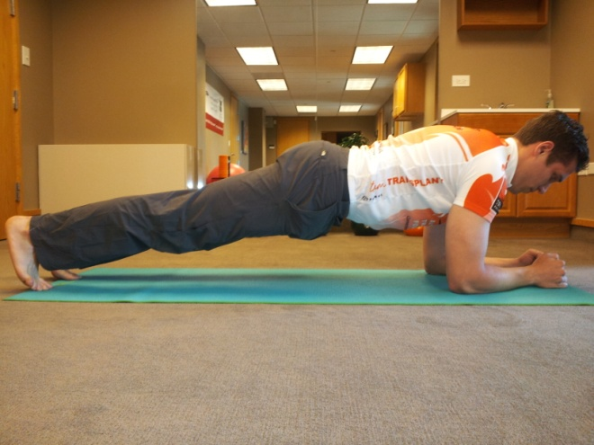
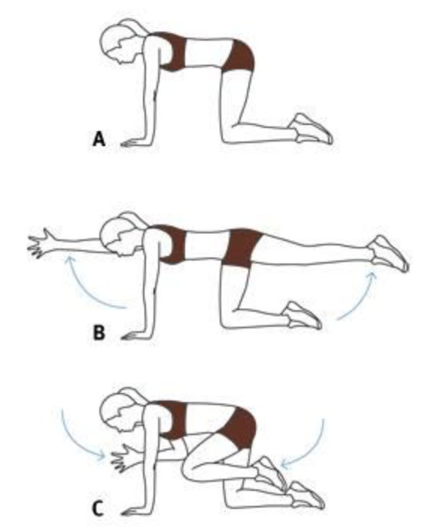
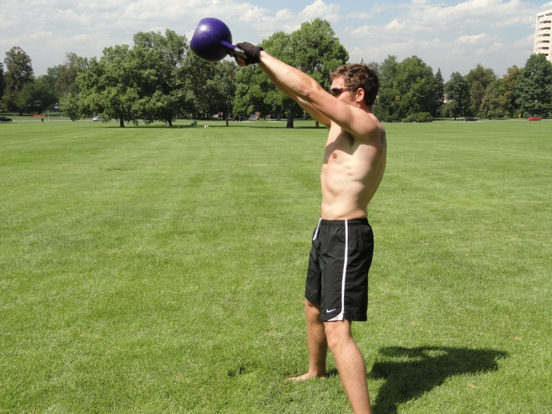
Treatment for Low Back Pain
Core Strengthening
Front Plank
Bird Dog
Kettlebell Swing

Slide 11
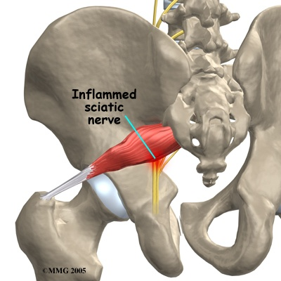
Piriformis Syndrome/ Sciatica
Causes
Constricted and tight musculature
Nerve entrapment
Possible lumbar (low back) disc involvement

Slide 12
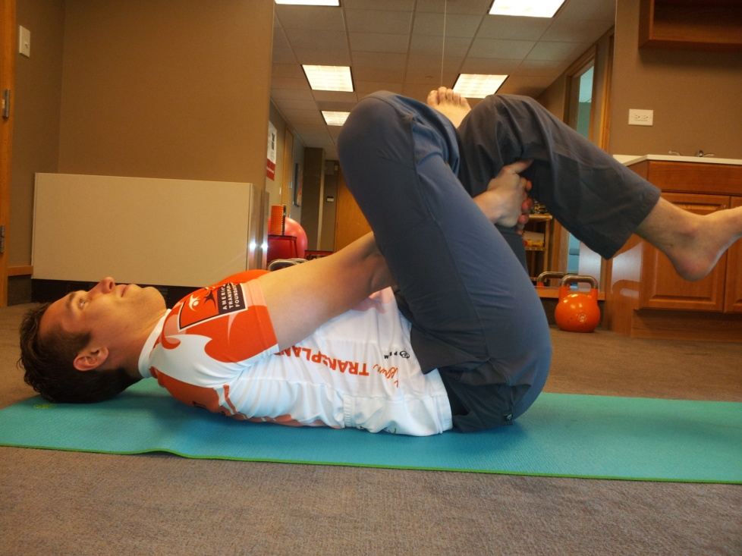
Treatment for Piriformis Syndrome
Myofascial Release
Piriformis Stretch
Joint Mobility

Slide 13
Knee Pain
Anterior (Front)
Patellofemoral Pain (Cyclist’s Knee) & Patellar Tendonitis
Lateral (Side)
Iliotibial Band Syndrome (IT Band)(Runner’s Knee)
Posterior (Back)
Hamstring

Slide 14
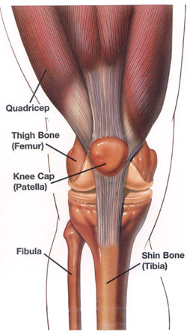
Patellofemoral Pain
Causes
1. Muscular Imbalance
(weak quadriceps)
2. Improper pedaling and
foot/cleat position
3. Seat too low or too high/
seat too far forward
4. Gears too high

Slide 15
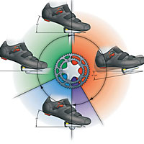
Treatment for Patellofemoral Pain
Strengthen quads, gluteals/abductors, and hamstrings
Flexibility
Quadriceps
Hip Flexor (Iliopsoas & Rectus femoris)
Hamstrings
Proper pedaling mechanics

Slide 16
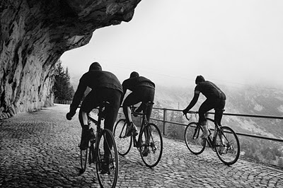
Patellar Tendonitis
Causes
Muscular Imbalances and Improper alignment
Seat too low/ too far forward
Treatment is similar to Patellofemoral Pain treatment

Slide 17
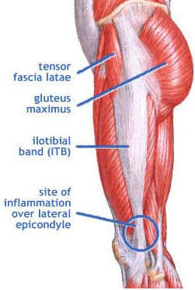
Iliotibial Band Syndrome (IT Band)
Causes- excessive friction of distal IT band near knee which can develop from:
Muscular Imbalances and improper alignment
Foot placement on pedal
Seat too far back and/or too high

Slide 18
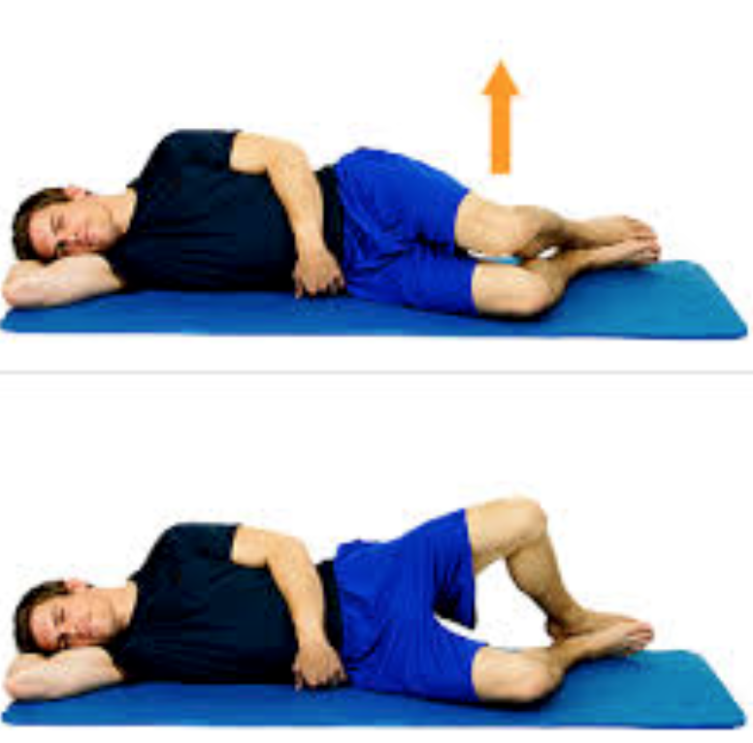
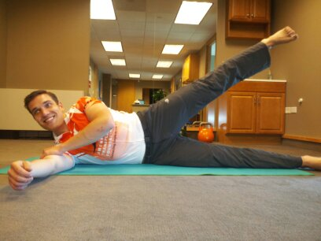
Treatment for IT Band Syndrome
Myofascial release (foam roller)
Strengthen glutes and IT Band
Clam Shell
Side Lying Straight Leg Raises (SLR)
Proper pedaling mechanics

Slide 19
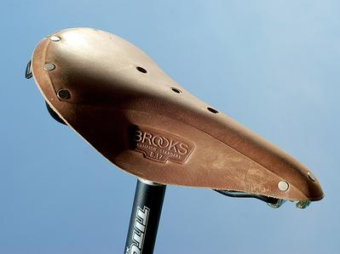
Hamstring Pain
Excessive load on muscle/tendon while knee is extended
Causes
Muscular Imbalances & Asymmetries
Previous injury
Seat too high
and/or too far back

Slide 20
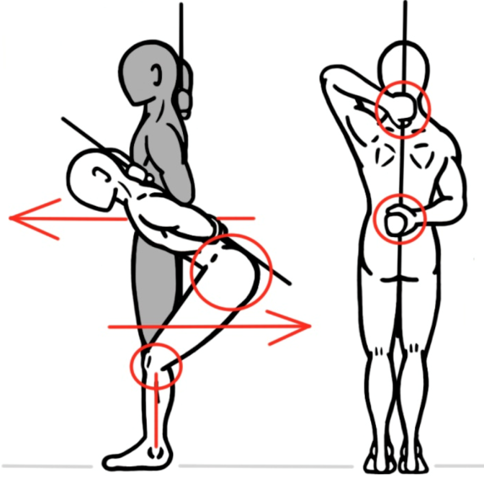
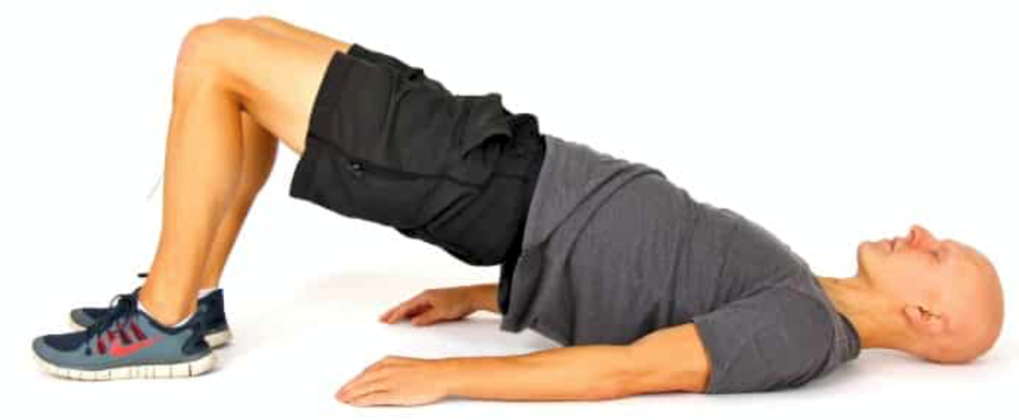
Treatment for Hamstring Pain
Strengthen hamstrings with eccentric loading
Hip Hinge
Glute Bridges
Proper pedaling mechanics

Slide 21
Ulnar Palsy/Carpal Tunnel Syndrome
Compression of ulnar and median nerves in the wrist which lead to numbness and tingling in hands and fingers
Causes
Improper positioning on handlebars and poor weight distribution
Long rides and/or rough terrain

Slide 22
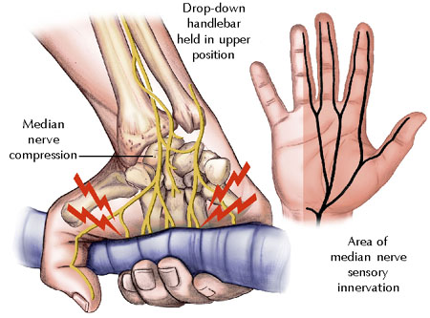
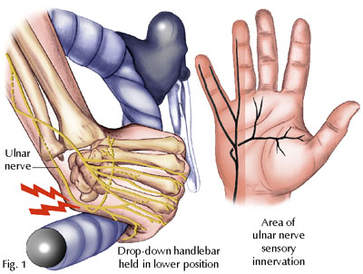
Treatment for Ulnar Palsy/CTS
Alter riding position to take pressure of nerves
Try riding with padded gloves and/or bar tape
Joint mobility in wrist and fingers
Strengthen wrists and fingers
Myofascial Release

Slide 23
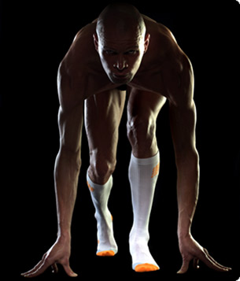
PRICE
P – Protect
R – Rest
I – Ice (20 min. on/ 40 min. off)
C – Compress
E- Elevate

Slide 24
Beginning Strength Program for Cyclists
3-5x/wk
Bodyweight training completed as a circuit (finish each exercise after the other with minimal rest)
Promotes a lean physique w/functional & dynamic strength and mobility
ALWAYS stress proper form (straight, neutral spine)

Slide 25
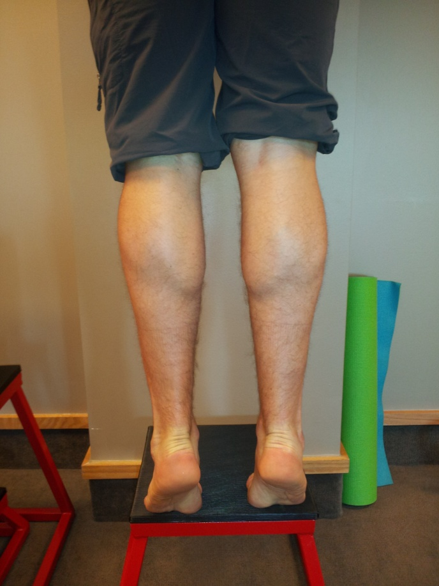
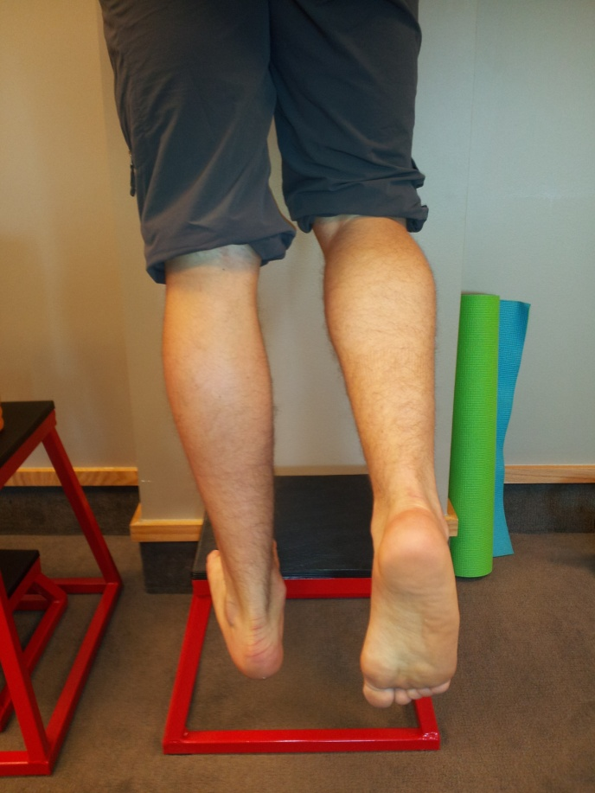
1)Eccentric Calf Raises
Standing with both toes on a raised surface, rise all the way up, then with one foot slowly lower (eccentric) until bottom position. Use both feet to rise back up. 3 sets of 10/foot.

Slide 26
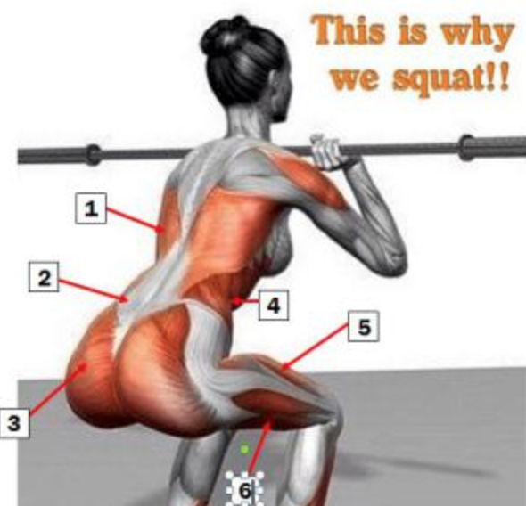
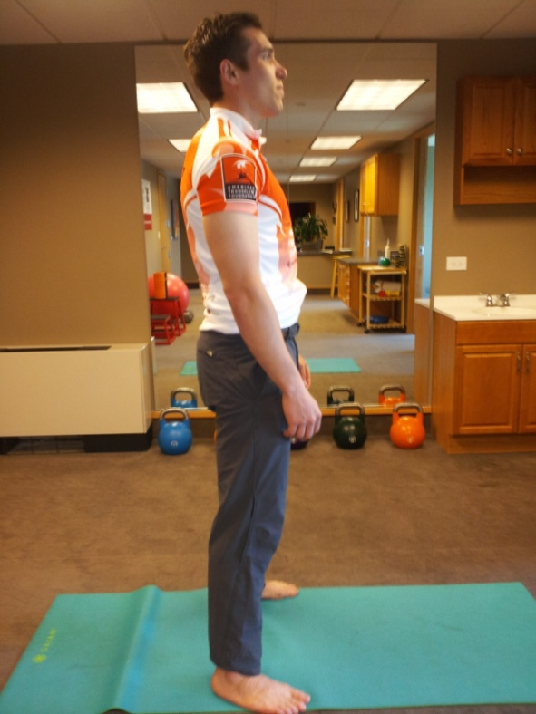
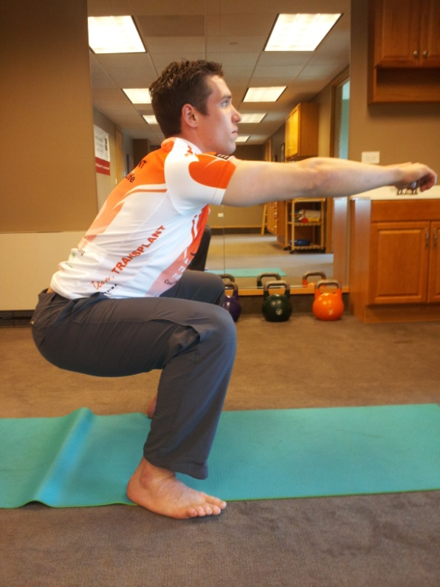
2)Bodyweight Squat
With heels slightly wider than shoulder width and toes slightly pointing out, slowly sit back and lower the hips until your thighs are parallel to the floor. When rising, “spread” the floor with the outside of your feet. Remember to keep weight on your heels, feet flat, spine tall, chest up, and don’t let your knees go in front of your toes or cave in (valgus). 3 sets of 10.

Slide 27
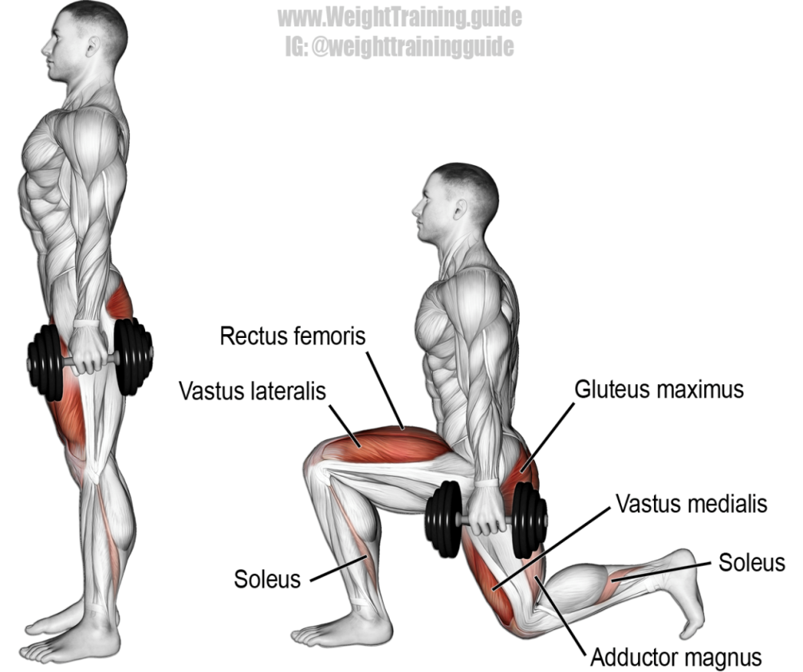
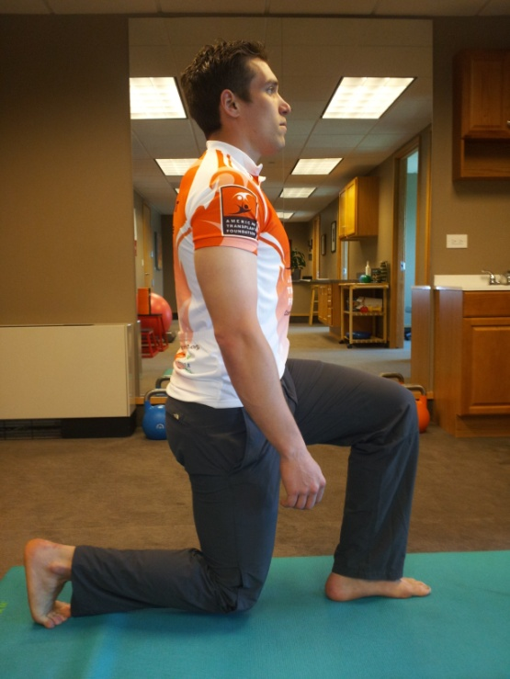
3) Backward In-Line Lunge
Step back with one leg and keep the back foot in-line with the front foot (stresses core & balance). Lower the hips while keeping the torso tall until front thigh is parallel to the floor. Keep front knee directly over front foot. The back knee can brush the floor, but don’t rest it there. Step back up to starting position. Perform all reps on one side first. 3 sets of 10/leg.

Slide 28
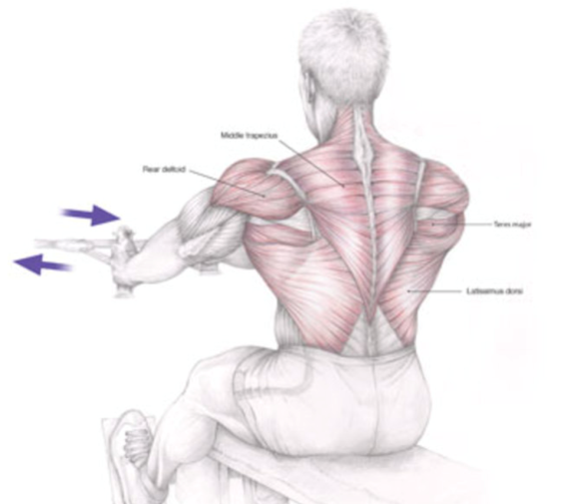
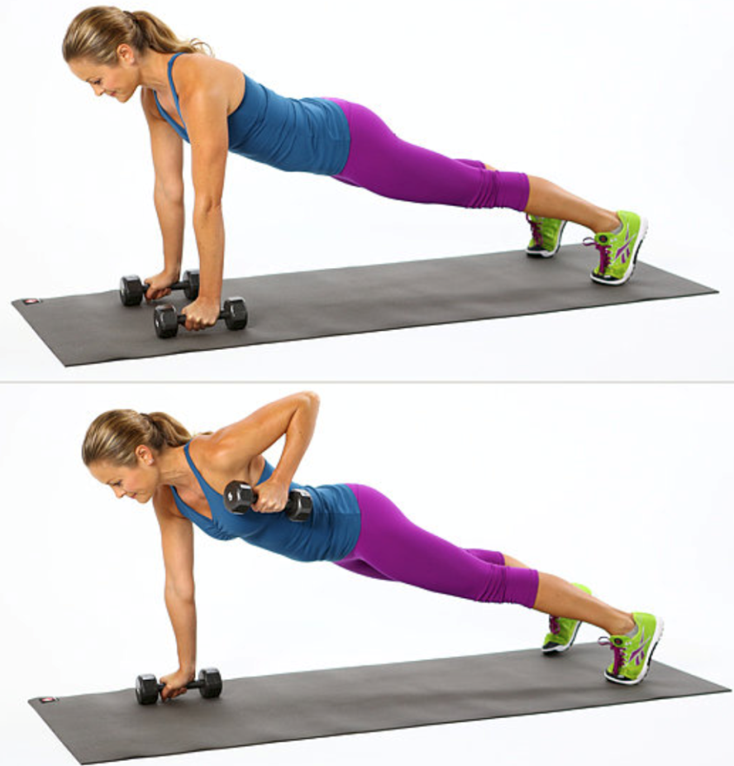
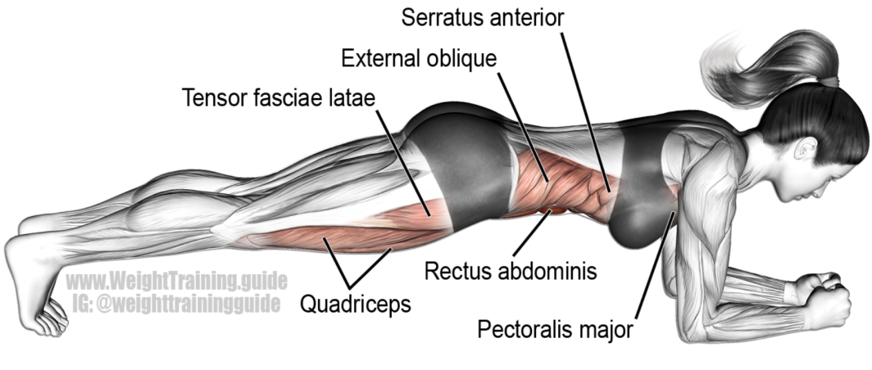
4)Front Plank Rows
Get into a push-up position with the core tight and back straight; spread your feet so they are wider than shoulders. Slowly raise one arm and pull elbow up until your fist is touching your side. Keep the core engaged and tight and DO NOT let your hips sag down. Perform all reps on one side, then switch. 3 sets of 10/arm.

Slide 29
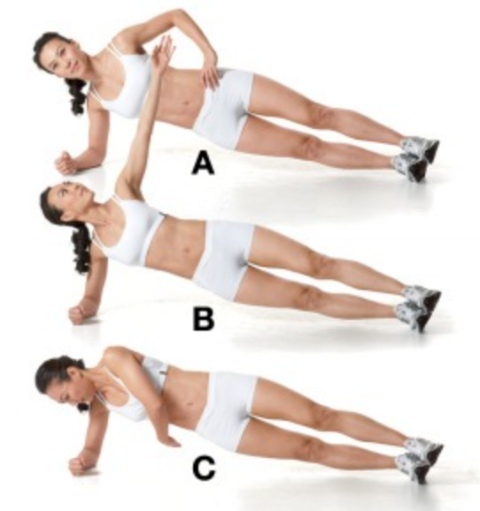
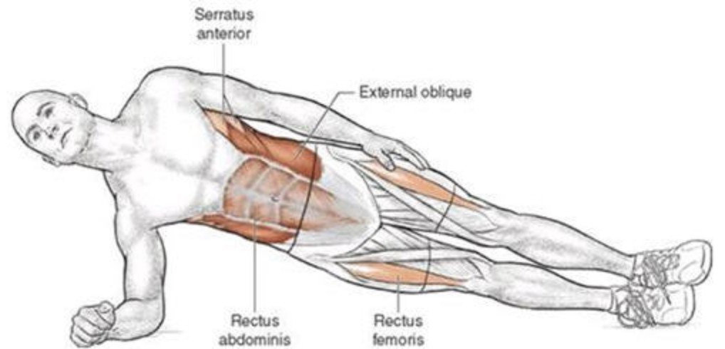
5) Side Plank Taps
Begin in a side plank position (either on your knees or up on feet). Keep the bottom elbow directly under shoulder for stability. Raise top arm until fully extended, slowly reach with that arm down and tap below body next to elbow on ground. Keep spine in a straight line by staring straight ahead, and DO NOT let the hips sag down. Perform all reps on one side then switch. 3 sets of 10/side.

Slide 30
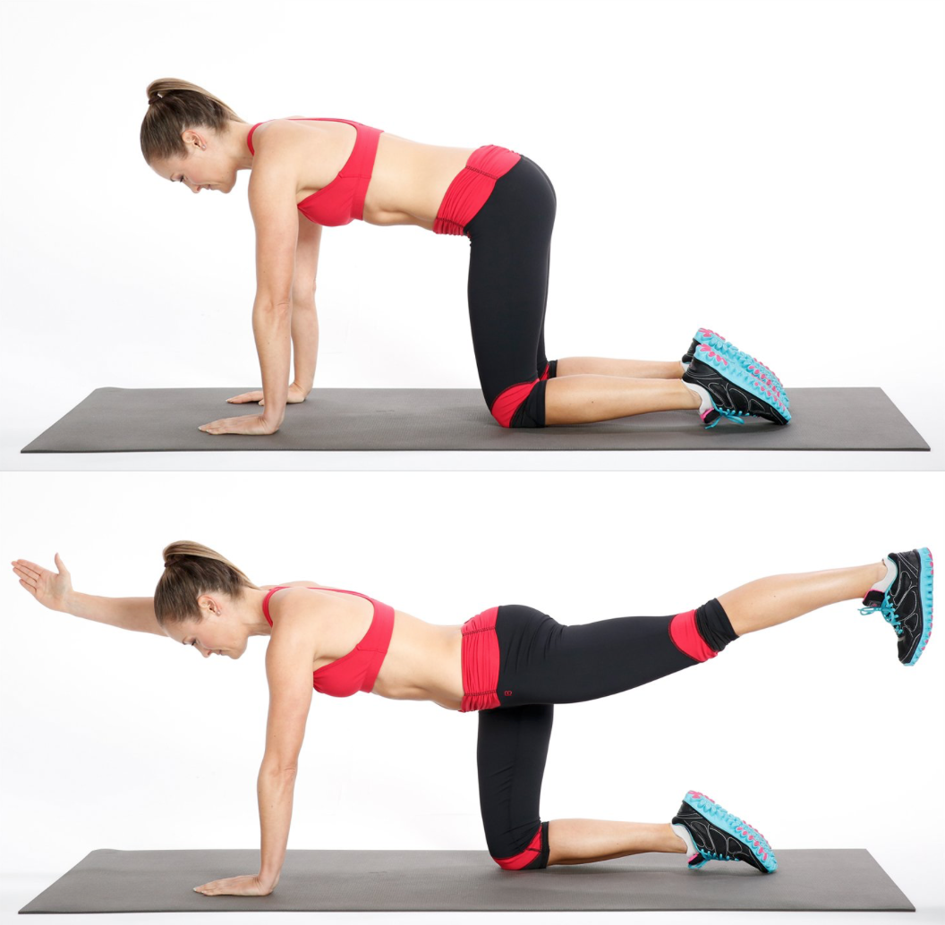
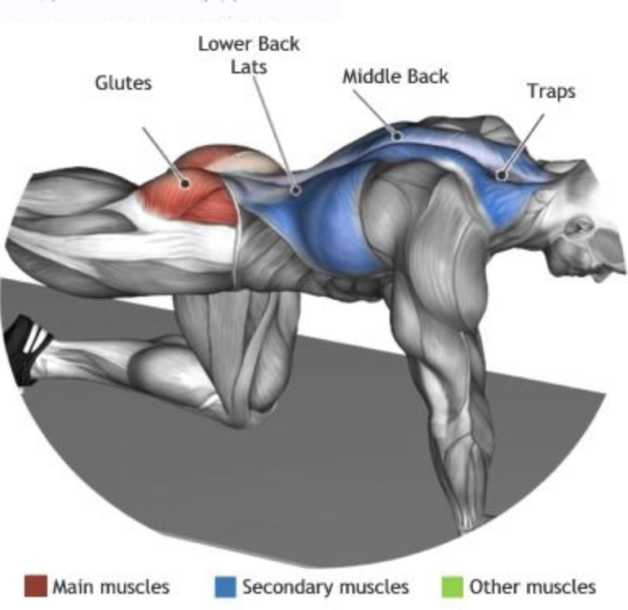
6) Bird Dog
Begin on hands & knees, with knees directly below hips & wrists/elbows directly beneath shoulders. Keep spine in neutral position throughout exercise. Slowly extend right arm and left leg until they are parallel to the floor, then return to starting position. Perform all reps like that and then switch to left arm/right leg. 3 sets of 10/side.

Slide 31
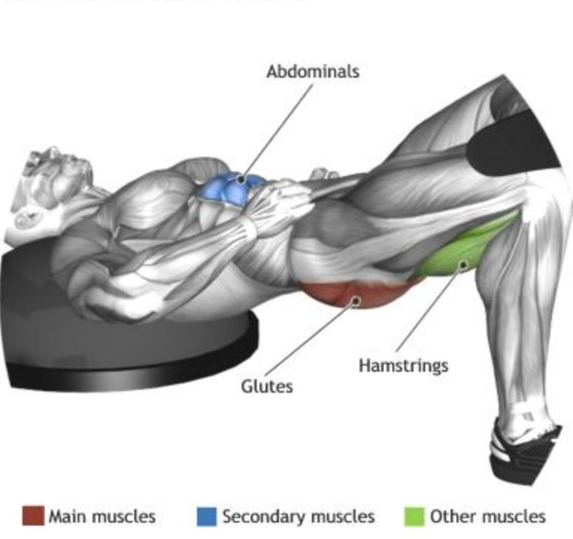
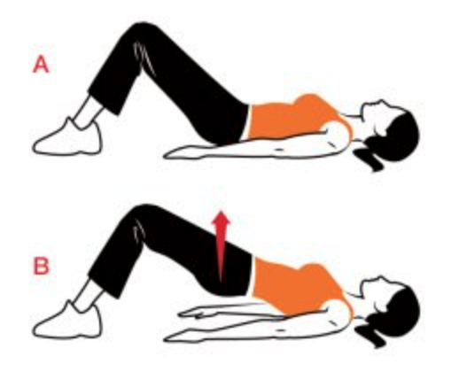
7) Glute Bridge
Begin lying on your back with knees flexed with your heels close to your glutes. Drive your shoulder blades into the ground while raising the hips until they are fully extended. Pause at the top, then slowly lower yourself to starting position and flatten the low back to the ground. 3 sets of 10.

